Slide 1
What's All the Hoopla?
How to use this FREE library resource
Presented by Cameron O'Steen
Cameron.OSteen@usm.edu

Slide 2
Did we mention it is free?
What can you get with Hoopla?
Books
Audiobooks
Magazines
Comics
Movies
Music
TV Series

Slide 3
Enjoy books, movies, shows, and music from home

Slide 4
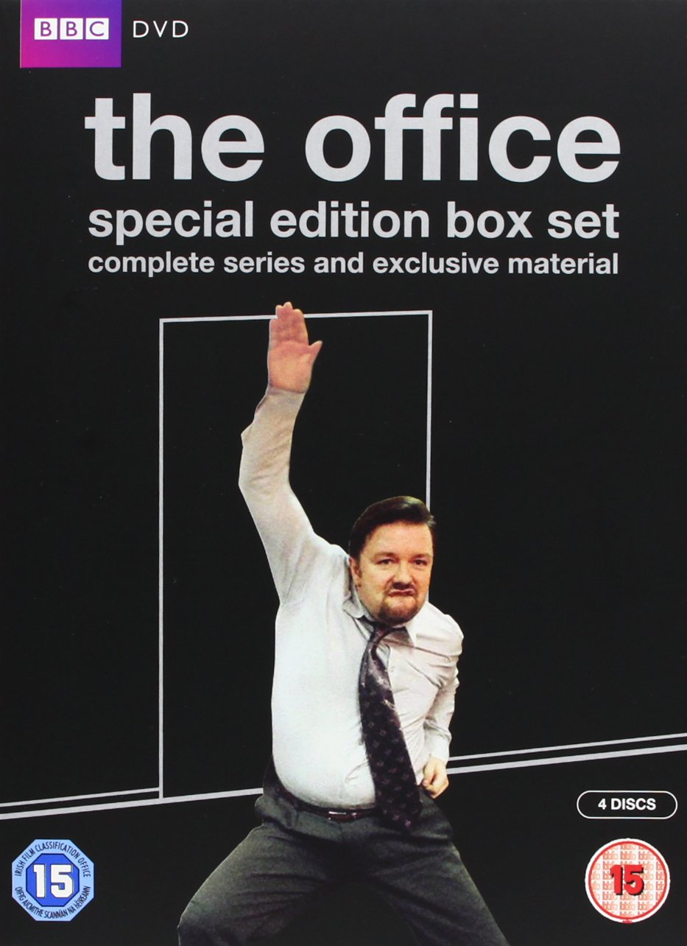
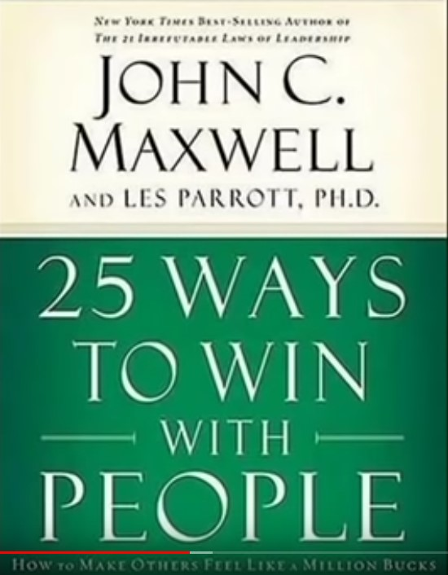
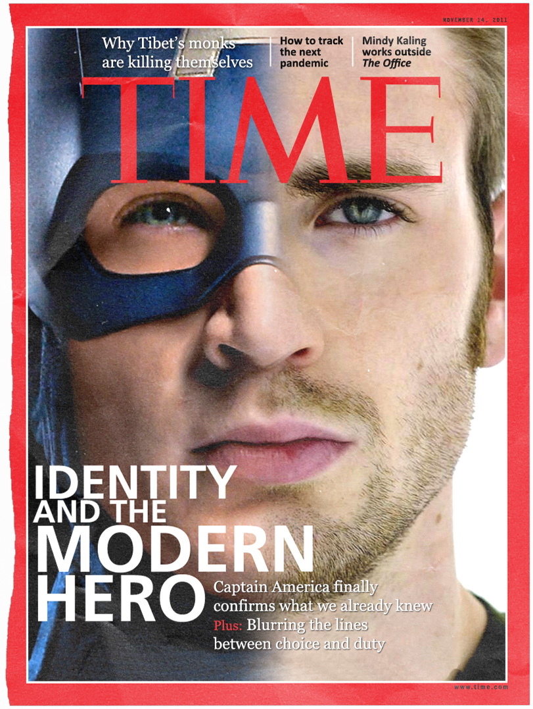
But is there anything good? As of November 2023
This Photo by Unknown author is licensed under CC BY-NC-ND.
This Photo by Unknown author is licensed under CC BY-NC-ND.
This Photo by Unknown author is licensed under CC BY-SA.
This Photo by Unknown author is licensed under CC BY-NC-ND.
This Photo by Unknown author is licensed under CC BY-SA.
This Photo by Unknown author is licensed under CC BY-NC-ND.
This Photo by Unknown author is licensed under CC BY-SA.
This Photo by Unknown author is licensed under CC BY-NC-ND.
This Photo by Unknown author is licensed under CC BY-SA.
This Photo by Unknown author is licensed under CC BY-SA-NC.

Slide 5
Features of Hoopla
No ads
Private browsing history
Instant borrows
Rotating titles each month
Automatic title returns
Favorites list

Slide 6
How do I sign up? Part 1
Tablet
Download the Hoopla app for
Phone
Tablet
Web browser
2. Input your library card number when prompted
Phone
Smart TV
Web browser

Slide 7
How do I sign up? Part 2
3. For your Smart TV:
Download to your compatible device – Roku, Apple TV, Android TV, Fire TV, & Chromecast
Initiate the option to link your account
Open Hoopla app on phone or tablet and go to settings (gear icon)
Choose the option to link a streaming device
Enter the code that appears on your TV
4. Browse away!
Tablet
Phone
Smart TV
Web browser

Slide 8
How long can I borrow items? | How many items can I borrow?
ebooks & audiobooks: 21 days | Varies by library subscription Typically 5 – 20 items each month
movies & tv shows: 72 hours | Instant Borrow means no waitlists Flexible Borrow means limited concurrent checkouts
What's all the Hoopla? 11-15-2023

Slide 9
Bonus things!
Many subscriptions will offer Hoopla BingePasses!
These are free 7-day periods for great programs like:
Curiosity Stream
The Great Courses
Hallmark Movies Now
The Highlights Collection
And so many more!

Slide 10
Thanks for watching, now get your Hoopla on!
Questions?
Reach out to me!
Cameron O'Steen
Cameron.OSteen@usm.edu

